Slide 1
Lecture 24: AB Testing 2 and Wrap-up

Slide 2
ANNOUNCEMENTS
Homework 8:
Completely on ED. Will be posted tonight. Partners allowed.
It will be about half as long as a typical HW.
Project:
Website (45 points) and notebook (30 points) due on Wed, 12/11
Individual peer evaluations (5 points) due on Thurs, 12/12
Details: https://github.com/Harvard-IACS/2019-CS109A/blob/master/content/projects/ProjectGuidelines.pdf

Slide 3
Outline
AB Testing: a Brief Review
Adaptive Experimental Design
Course Wrap-up

Slide 4
AB Testing: a Brief Review

Slide 5
Assessing Causal Effects
Most data are collected observationally, without intervention into what measurements the predictors take on.
It is difficult to assess causality in an observational study and may even be impossible. You never know if all confounders are accounted and controlled for properly.
An experiment (called AB test in the world of Data Science) can be conducted to determine causal relationships between a treatment and a response, but they come with their own drawbacks (artificial, expensive, etc.).

Slide 6
AB Testing and Experimental Design
Many flavors of AB tests. 3 key characteristics:
Comparison/control group
Random assignment of treatment to subjects
Repetition (to ensure balance).
Completely Randomized Design (CRD) is like pulling names out of a hat. Stratified Randomized Design performs a CRD within strata.
The multivariate experimental design generalizes this approach. If there are two treatment types (font color, and website layout), then both treatments’ effects can (and should) be tested simultaneously.

Slide 7
Analyzing the results: should be easy

Slide 8
Adaptive Experimental Design

Slide 9
Beyond CRD designs
The approaches we have seen to experiments all rely on the completely randomized design (CRD) approach. There are many extensions to the CRD approach depending on the setting. For example:
If there are more than two types of treatments (for example: (i) font type and (ii) old vs. new layout), then a factorial approach can be used to test both types of treatments at the same time.
If the treatment effect is expected to be different across different subgroups (for example possibly different for men vs. women), then a stratified/cluster randomized design should be used.

Slide 10
Beyond CRD designs (cont.)
These different experimental designs will need to have adjusted analysis approaches to analyze them appropriately.
Examples:
factorial design: a multi-way ANOVA when the response variable is quantitative.
stratified analysis: the Mantel-Haenszel test for cluster randomized design with a categorical response variable.

Slide 11
Beyond CRD designs (cont.)
But all of these procedures rely on the fact that there is a fixed sample size for the experiment. This has a glaring limitation: you have to wait to analyze until n is recruited/reached.
If you peak at the results before n is reached, then this is a form of multiple comparisons and thus overall Type I error rate is inflated.

Slide 12
Bandit Designs
A sequential or adaptive procedure can be used if you would like to intermittently check the results as subjects are recruited (or want to look at the results after each and every new subject is enrolled).
One example of a sequential test/procedure is a bandit-armed design. In this design, after a burn-in period based on a CRD, then the treatment that is performing better is chosen more often to be administered to the subjects.

Slide 13
Bandit Design Example
For example, in the play the winner approach for a binary outcome, if treatment A is successful for a subject, then you continue to administer this treatment to the next subject until it fails, and then you skip to treatment B, and vice versa.
The advantage to this approach is that if one treatment is truly better, then the number of subjects exposed to the worse treatment is lessened.
What is a major disadvantage?

Slide 14
Bayesian Bandit Designs
Our friend Bayes’ theorem comes into play again if we would like to have a bandit design for a quantitative outcome.
The randomization to treatment for each subject is based on a biased coin, where the probability of being assigned to treatment A is based on the poster probability that treatment A is a better treatment.

Slide 15
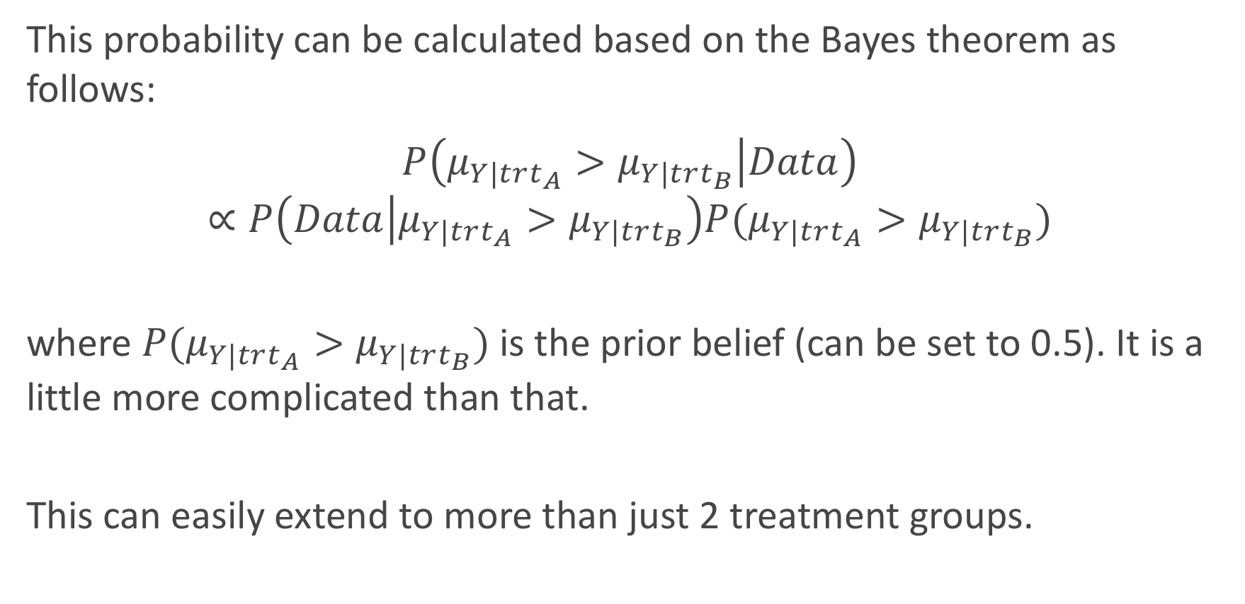
Bayesian Bandit Designs (cont.)
This probability can be calculated based on the Bayes theorem as follows:
$$P\left(μ_{Y|trt_{A}}>μ_{Y|trt_{B}} | Data\right)$$
$$∝P\left(Data | μ_{Y|trt_{A}}>μ_{Y|trt_{B}}\right)P(μ_{Y|trt_{A}}>μ_{Y|trt_{B}})$$
where $P(μ_{Y|trt_{A}}>μ_{Y|trt_{B}})$ is the prior belief (can be set to 0.5). It is a little more complicated than that.
This can easily extend to more than just 2 treatment groups.

Slide 16
ECMO Trial: Bayesian Bandit Trial Example
In the 80’s a bandit-armed design (Bartlett, et al.) was used to determine whether or not Extracorporeal Membrane Oxygenation (ECMO) would improve survival (compared to ‘standard of care’) of neonatal patients (premature babies) experiencing respiratory failure.
In the end, only 11 patients were enrolled before “statistical significance” was achieved.
What is an issue with these results?

Slide 17
ECMO Trial

Slide 18
Analysis of Bayesian Approaches
So when should you stop an adaptively designed trial?
You could continue the trial until a p-value of less than 0.05 is achieved (or until a large sample size is taken without coming to a statistically significant result)?
What is an issue with this “stopping criterion”?
If our p-value is determined from a classical method, then this is an example of multiple comparisons: you have looked at the data at many points along the timeline, so a significant result is more likely to occur than 0.05 if there is not a true difference in the treatments.
We need to adjust how the ‘statistical significance’ is determined!

Slide 19
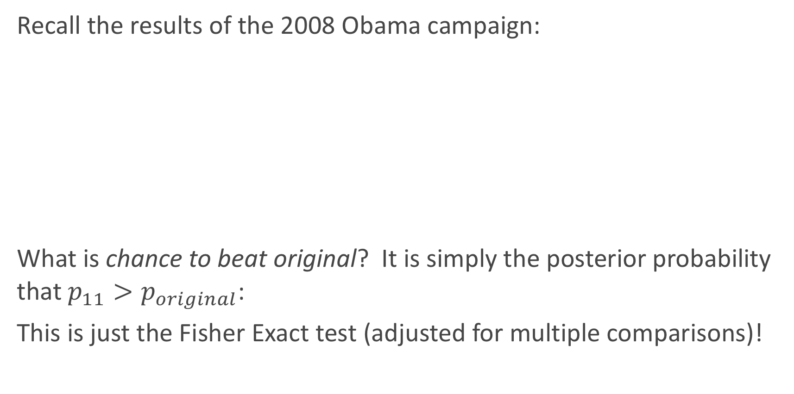
Thinking like a Bayesian
Recall the results of the 2008 Obama campaign:
What is chance to beat original? It is simply the posterior probability that $p_{11}>p_{original}$:
This is just the Fisher Exact test (adjusted for multiple comparisons)!

Slide 20
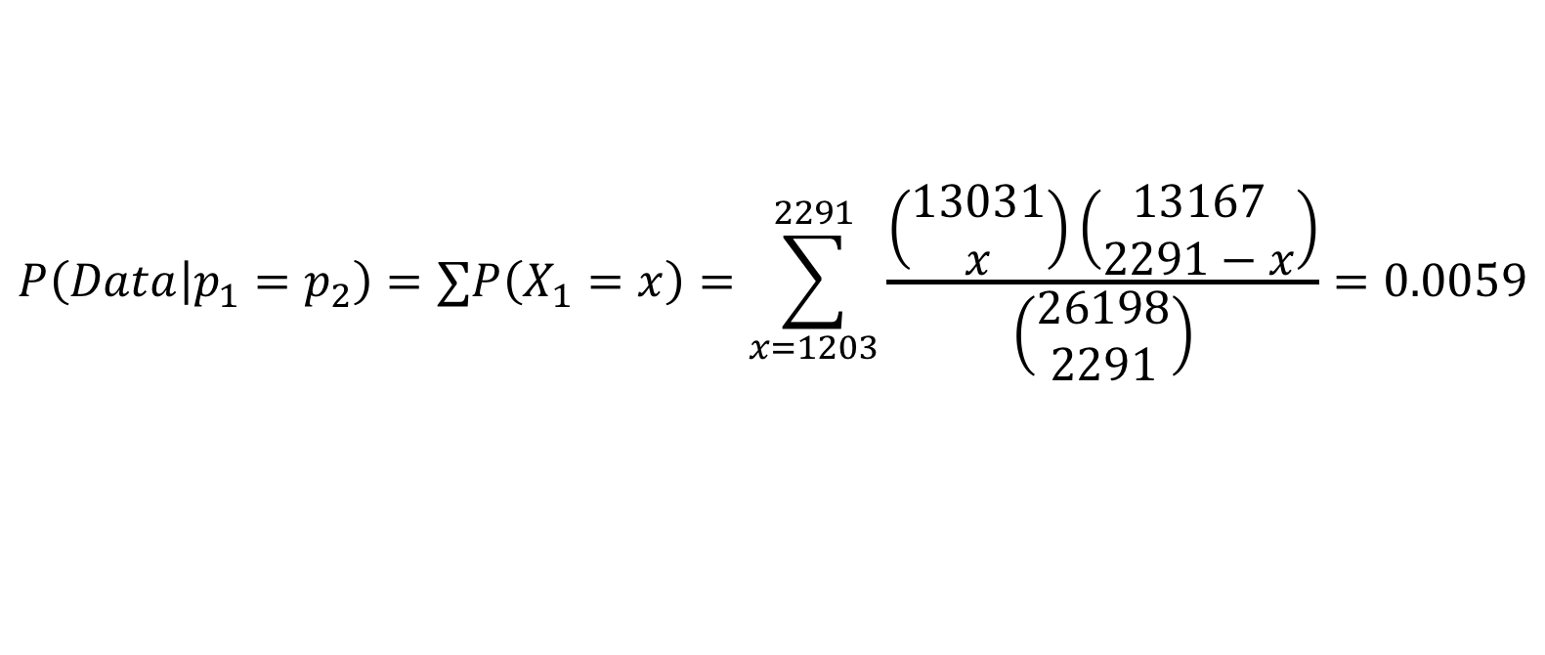
Thinking like a Bayesian
$$P\left(Data | p_{1}=p_{2}\right)=∑P\left(X_{1}=x\right)=\sum_{x=1203}^{2291}{\frac{\left(\begin{matrix}13031 \\ x\end{matrix}\right)\left(\begin{matrix}13167 \\ 2291−x\end{matrix}\right)}{\left(\begin{matrix}26198 \\ 2291\end{matrix}\right)}}=0.0059$$

Slide 21
Course Wrap-up

Slide 22
Things we haven’t discussed
There are lots of topics we have not covered in one semester…some are covered in 109B in the Spring:
Unsupervised Classification/Clustering
Smoothers
Bayesian Data Analysis
Reinforcement Learning
Other versions of Neural Networks (and ‘Deep Learning’)
Interactive Visualizations
Database Management (SQL, etc.)
Cloud Computing and Scaling (AWS)
And much, much more…

Slide 23
Courses Related to Data Science
CS 109B: Advanced Topics in Data Science
CS 109C: Very Advanced Topic in Data Science
CS 171: Visualizations
CS 181/281: Machine Learning
CS 182: Artificial Intelligence (AI)
CS 205: Distributive Computing
Stat 110/210: Probability Theory
Stat 111/211: Statistical Inference
Stat 139: Linear Models
Stat 149: Generalized Linear Models
Stat 195: Intro to Statistical Machine Learning
This list is not exhaustive!

Slide 24
The Data Science Process
Ask an interesting question
Don’t forget what everything is all about:
Get the Data
Explore the Data
Model the Data
Communicate/Visualize the Results

Slide 25

Thanks for all your hard work!
It’s been a long semester for everyone involved. Thank you for your patience, your hard work, and your commitment to data science!
It’s sad to see you go...

